Slide 1
Content-based Recommendation
Lu Zhang, Shitai Zhang

Slide 2
Content-based recommendation (CBR)
CBR features:
Means to describe the item
Means to create a profile of user that describes the types of items the user likers
Means to compare items to user profile

Slide 3
Item representation
Structured data
Unstructured data: free texts
Semi-structured data
id | color | price | cost
1 | red | 3 | 1
2 | green | 2 | 0.4
id | color | price | Cost description
1 | red | 3 | This is very high cost
2 | green | 2 | Super cheap

Slide 4
Vector Space Model
Vector space model or term vector model is an algebraic model for representing text documents (and any objects, in general) as vectors of identifiers, such as, for example, index terms. – wiki
Documents and queries are represented as vectors.
dj=(w1,j,w2,j,…,wt,j)
q=(w1,q,w2,q,…,wn,q)
Each dimension corresponds to a separate term. If a term occurs in the document, its value in the vector is non-zero.
Several different ways of computing these values, also known as (term) weights, have been developed. One of the best known schemes is tf-idf weighting (see the example below).

Slide 5
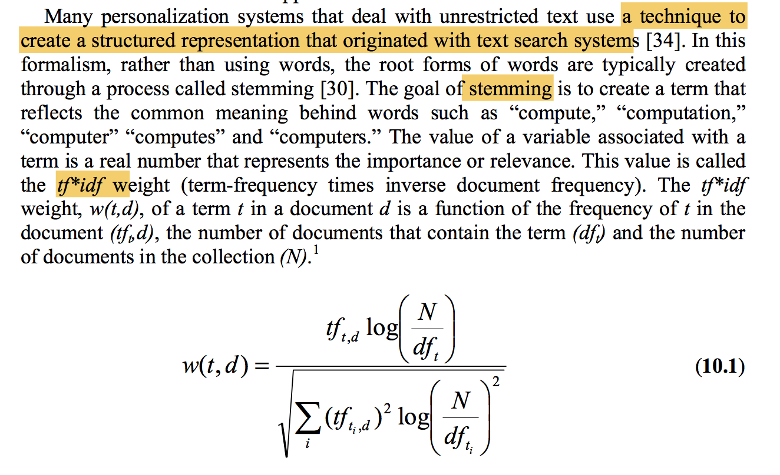
Tf-idf
But these models are bags of words representation, grammar are lost. One way to resolve this is to use contiguous words as terms

Slide 6
User Profile: a profile of user interest
A model of user preference: description of types of items that interest the user. A common one: a function that for any item predicts the likelihood the user is interested in that item
A history of user interactions with recommendation system: user customization and rule-based recommendation systems

Slide 7
Learning the User Model
Creating a model of users preference from the user history is classicization learning
Explicit (smaller data, more accuracy) and implicit (bigger data, less accuracy) methods
Classification Algorithms: given a new item and the user model, the function predicts whether the user would be interested in that item

Slide 8
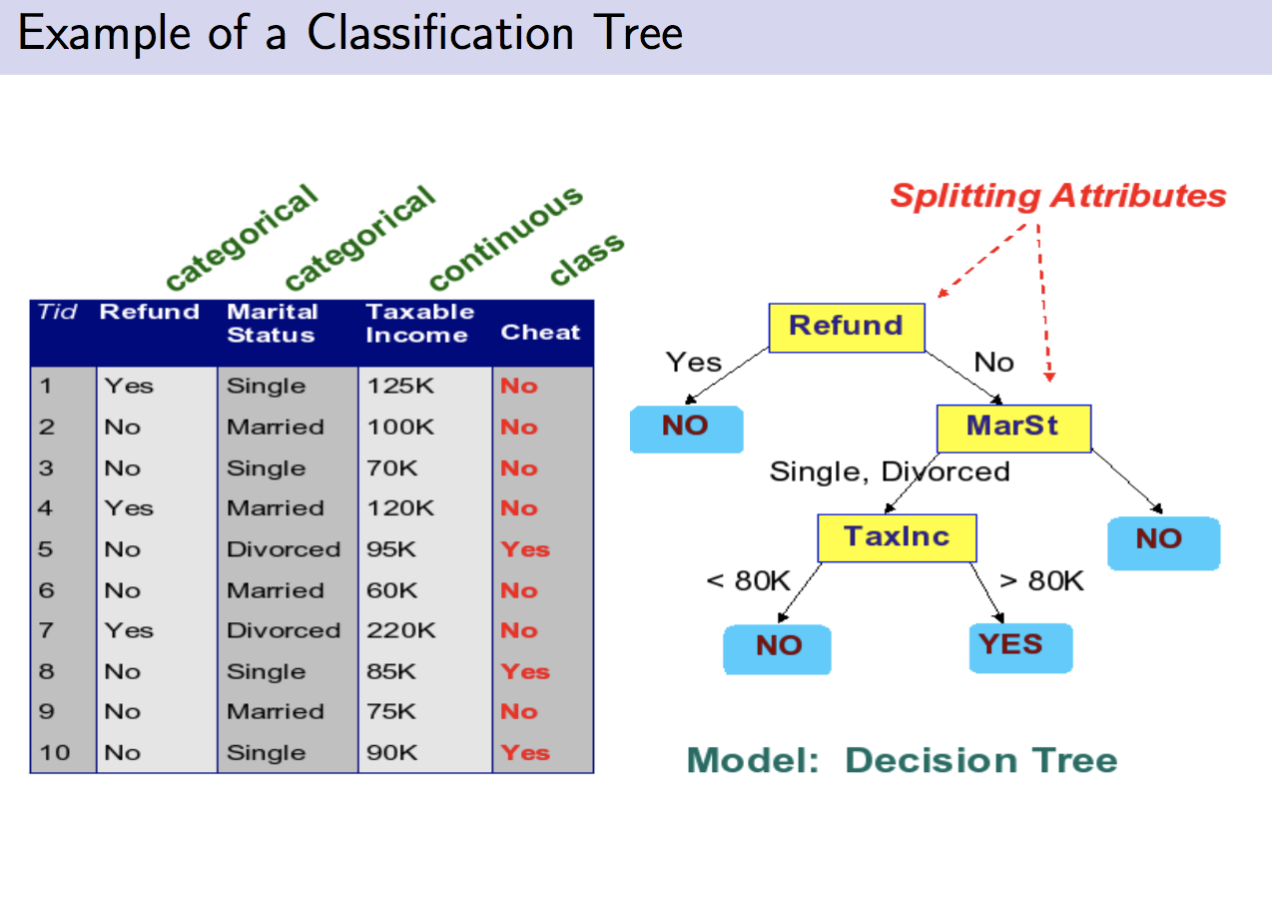
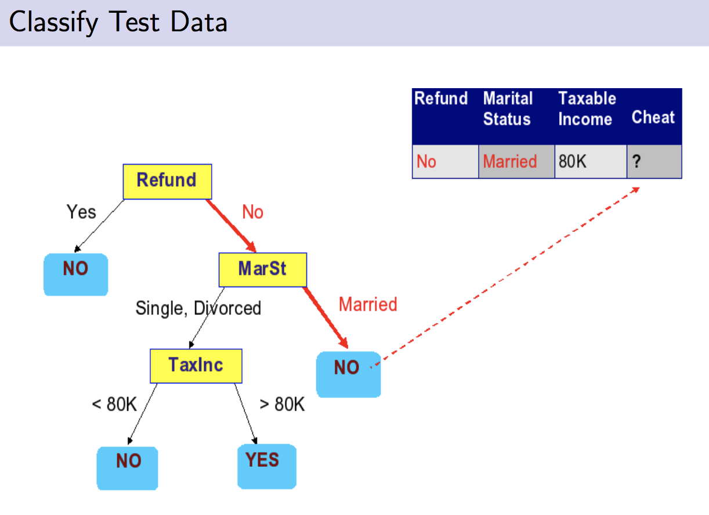
Classification Tree (based on text features)

Slide 9
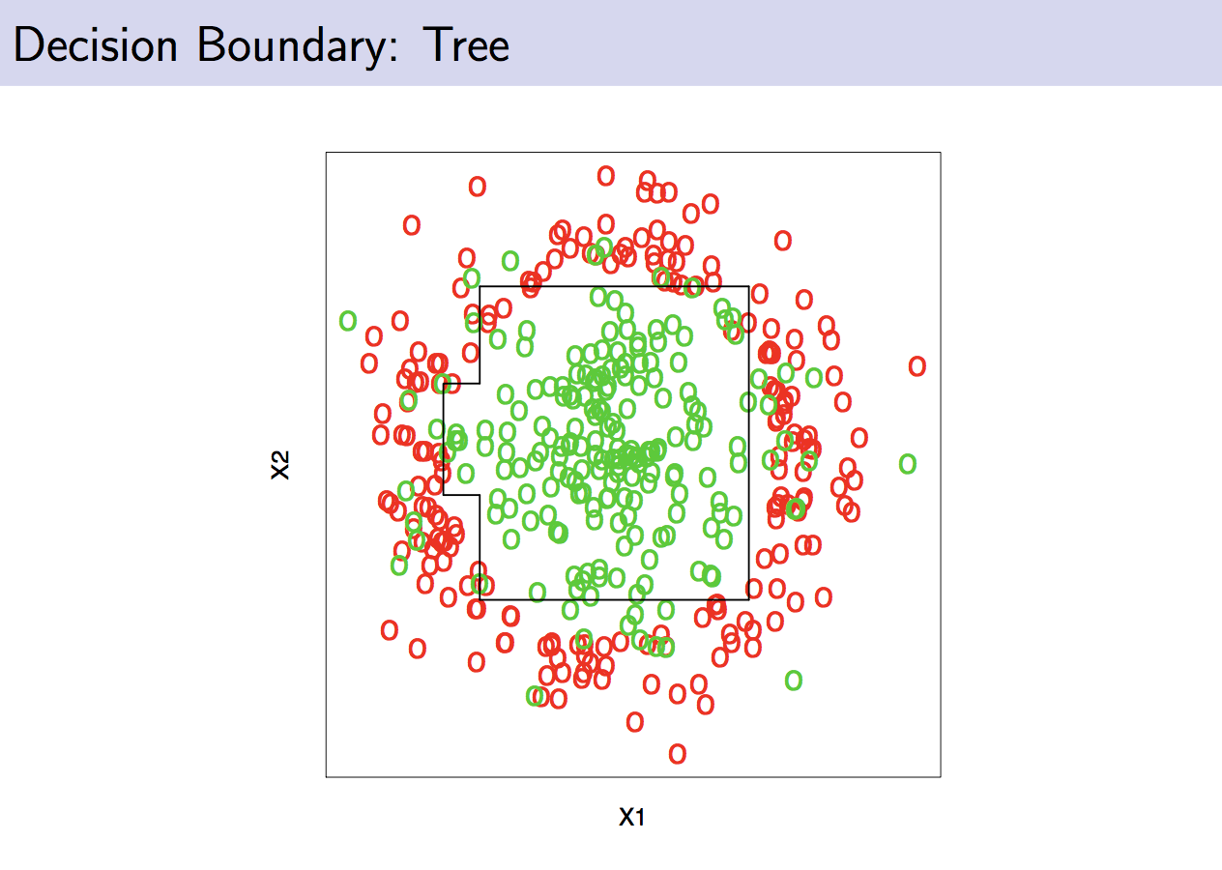
Classification Tree

Slide 10
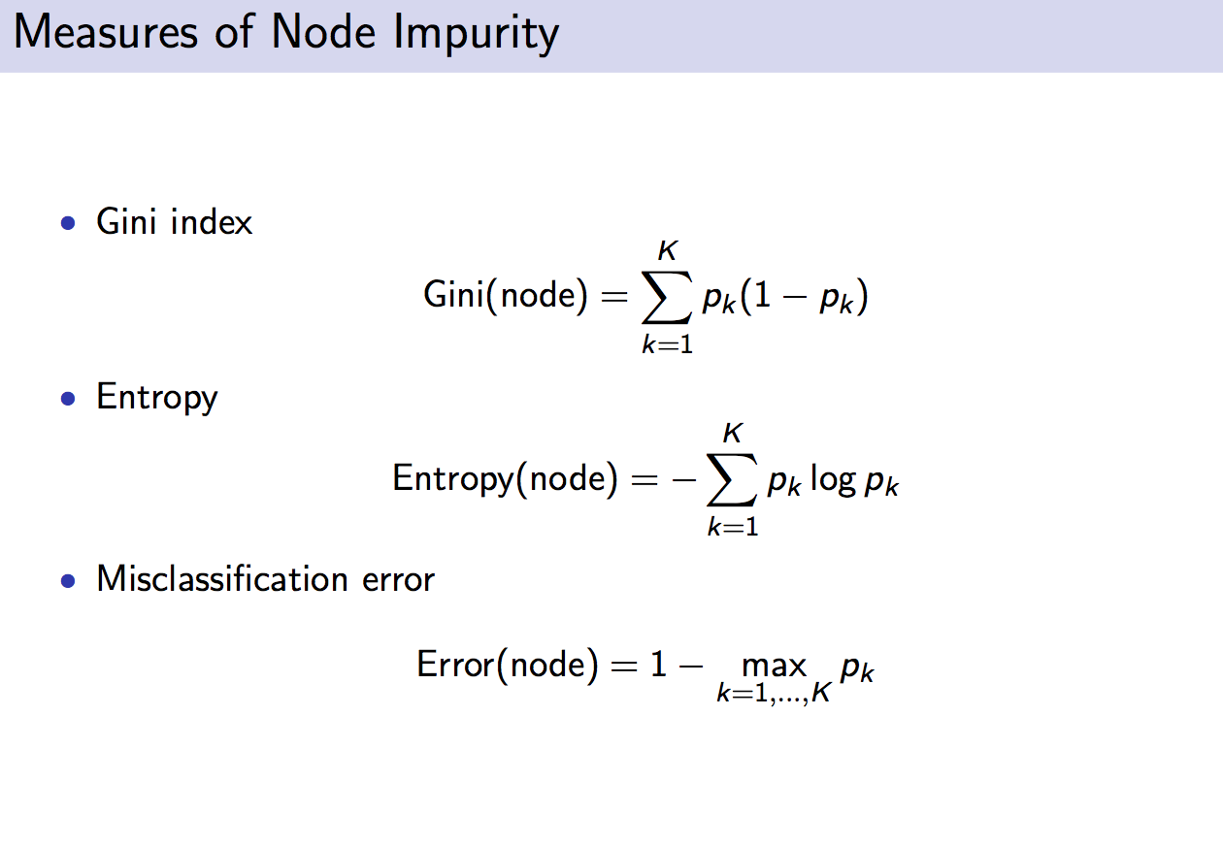
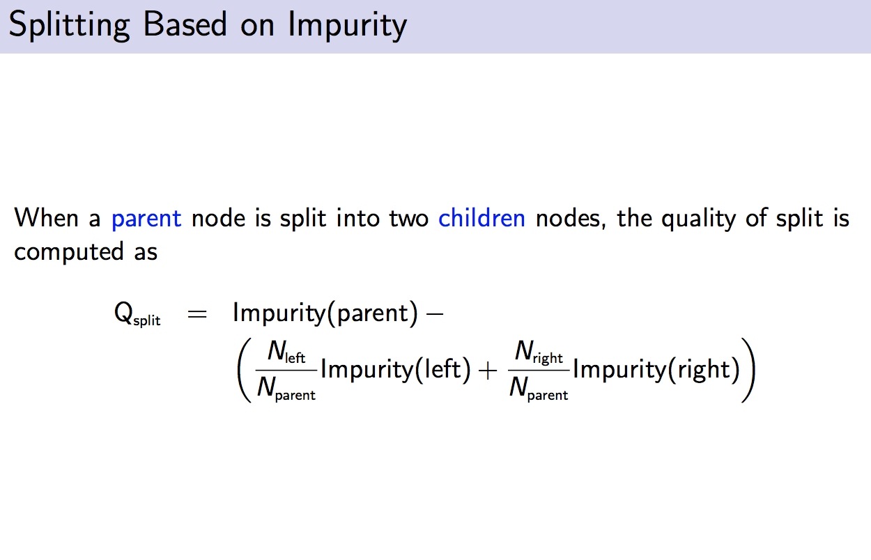
Splitting between Nodes

Slide 11
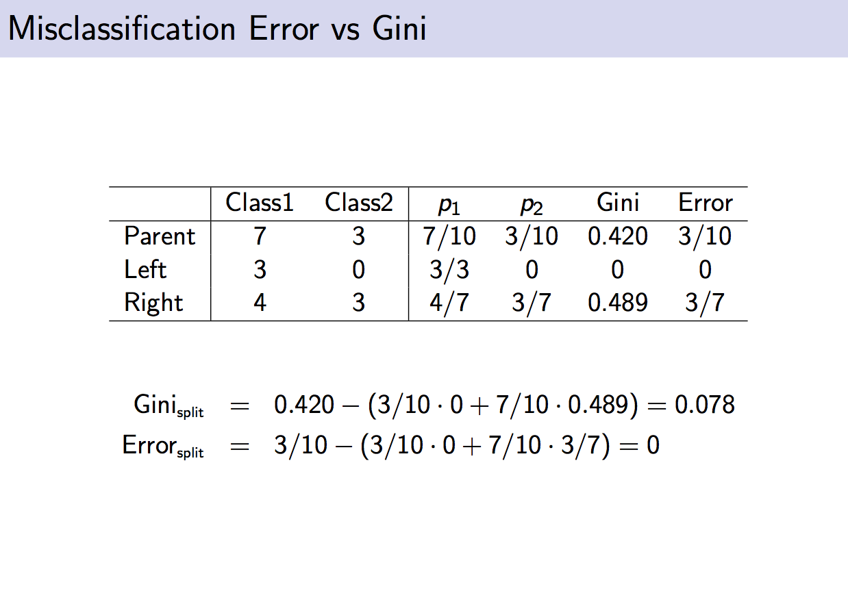
Example

Slide 12
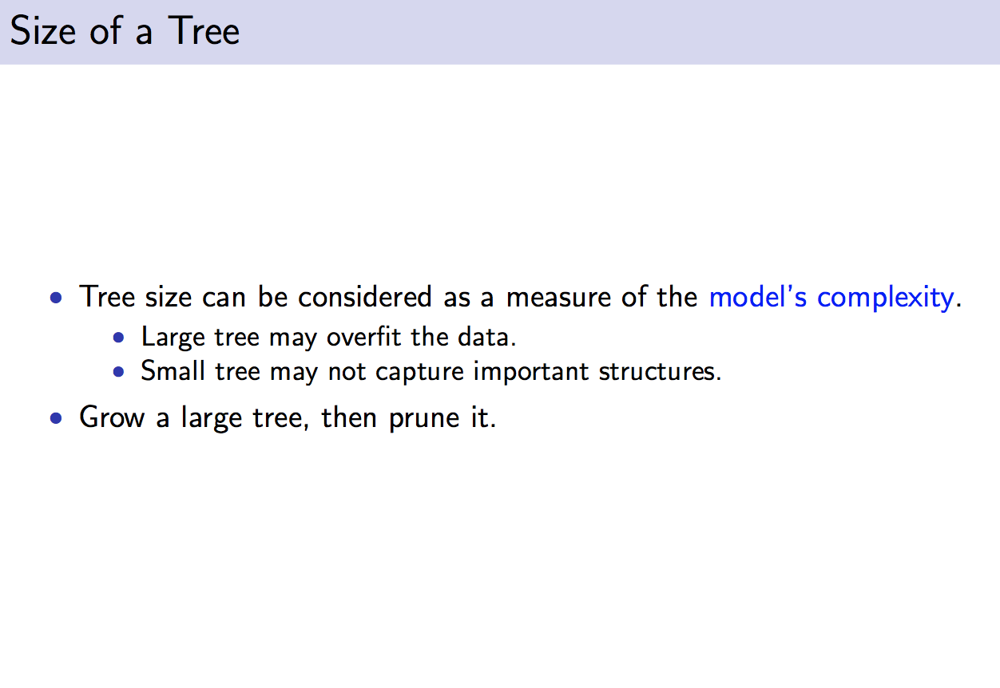
Classification Tree

Slide 13
Comments on Decision Tree
Work well on structured data
May not work very well on unstructured data (many features) for its tendency to rely on as few tests as possible (inductive bias)
Improvement: RIPPER (Repeated Incremental Pruning to Produce Error Reduction) to prune the tree (more powerful on semi-structured data)
Ripper intuitively: “…for rules algorithms, the training data is split into a growing set and a pruning set. First, an initial rule set is formed that over ts the growing set, using some heuristic method. This overlarge rule set is then repeatedly simplified by applying one of a set of pruning operators typical pruning operators would be to delete any single condition or any single rule. At each stage of simplification, the pruning operator chosen is the one that yields the greatest reduction of error on the pruning set. Simplification ends when applying any pruning operator would increase error on the pruning set.” - wiki

Slide 14
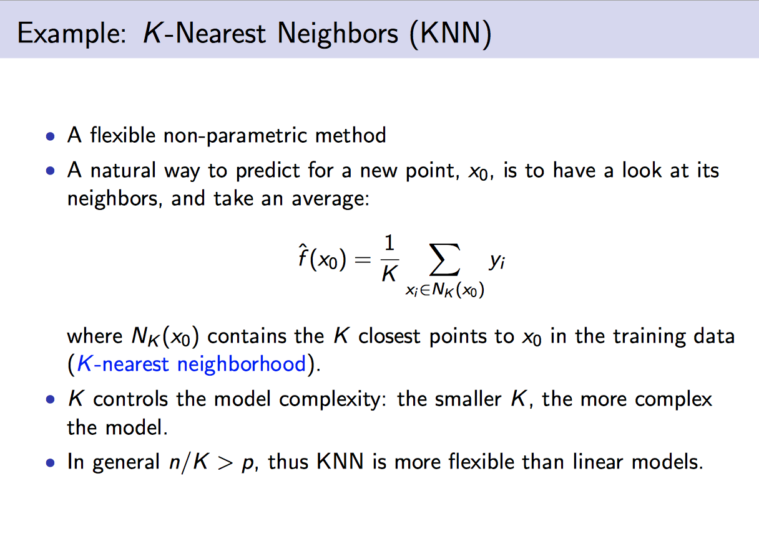
KNN

Slide 15
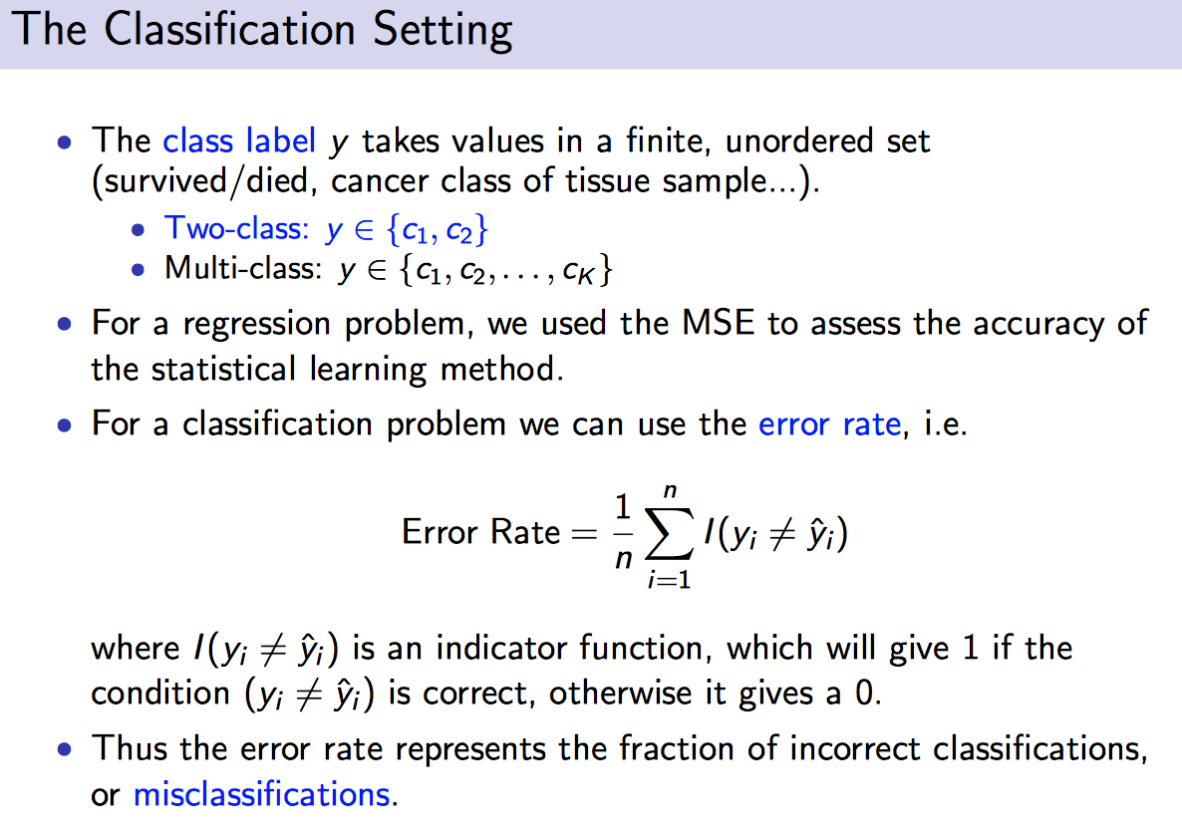
KNN on classification

Slide 16
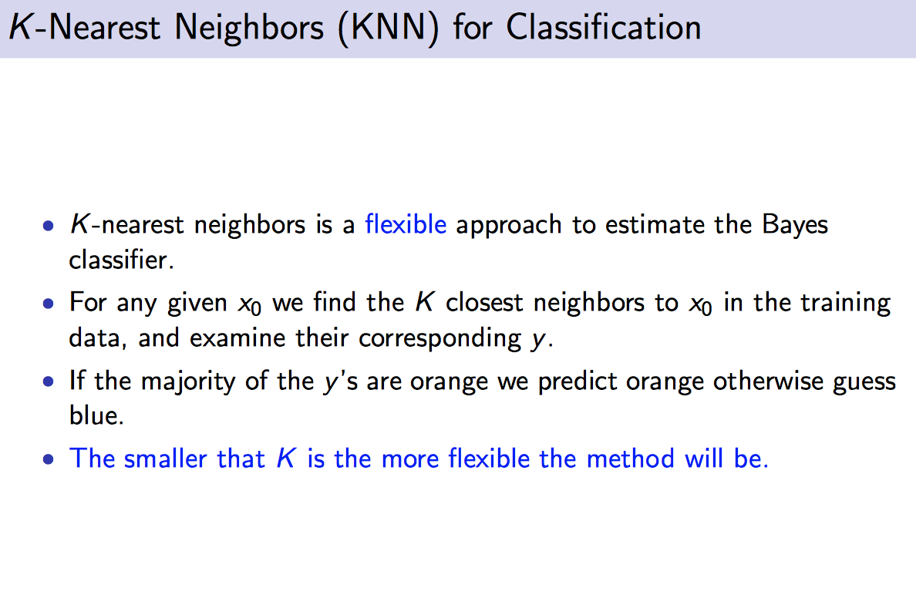
KNN for classification

Slide 17
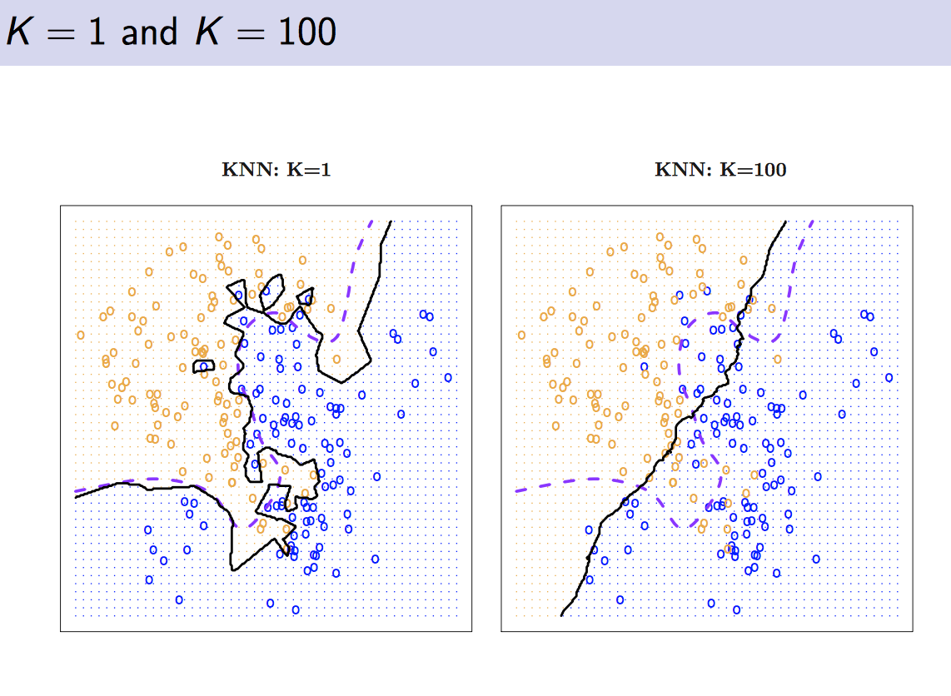
KNN example

Slide 18
Relevance Feedback and Rocchio’s Algorithm
Relevance Feedback: methods that help users incrementally refine queries based on previous search results
General principle: allow users to rate documents w.r.t. info they need
Explicit and implicit methods

Slide 19
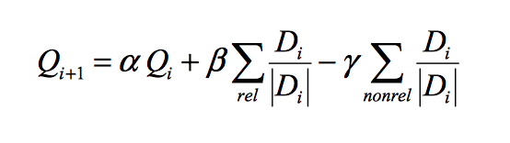
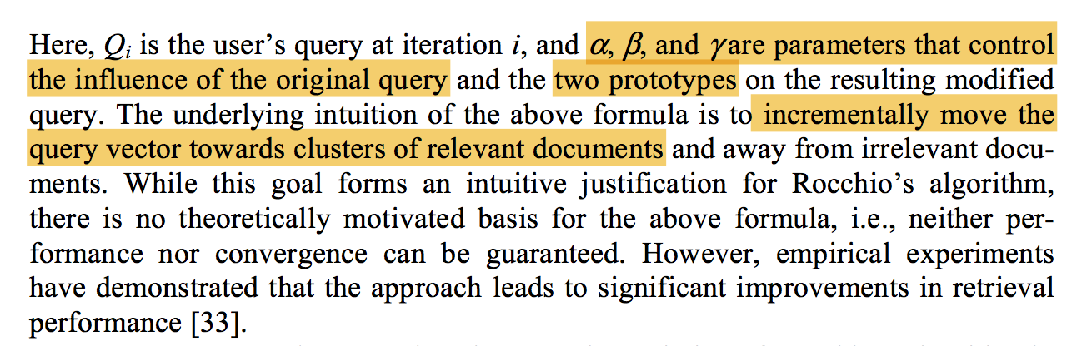
Relevance Feedback and Rocchio’s Algorithm
Rocchio’s Algorithm: modify initial query through differently weighted prototypes of relevant and non-relevant documents.

Slide 20
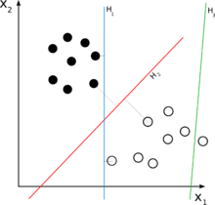
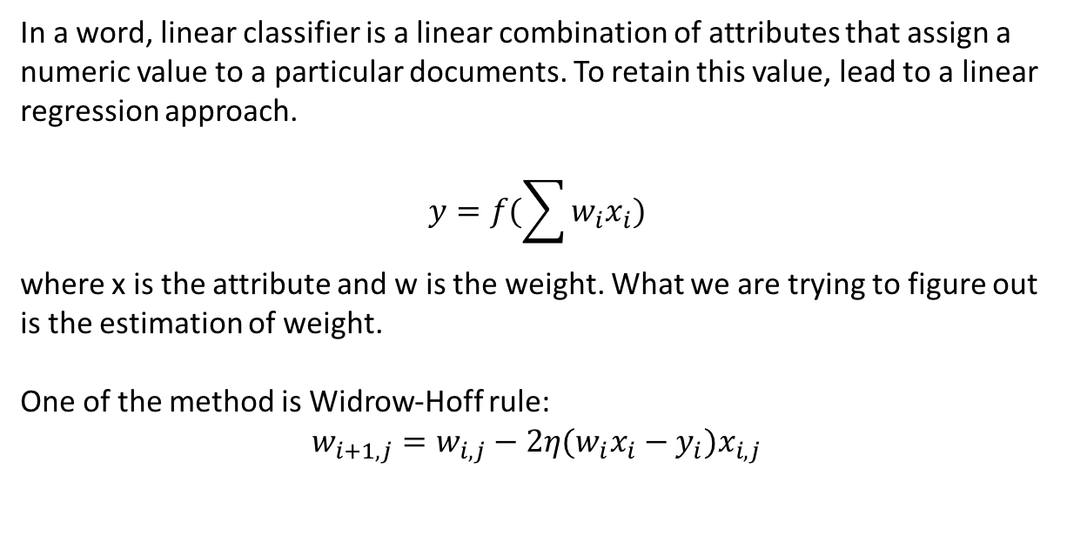
Linear Classifier
In a word, linear classifier is a linear combination of attributes that assign a numeric value to a particular documents. To retain this value, lead to a linear regression approach.
$$y=f(\sum{w_{i}x_{i}})$$
where x is the attribute and w is the weight. What we are trying to figure out is the estimation of weight.
One of the method is Widrow-Hoff rule:
$$w_{i+1,j}=w_{i,j}−2η(w_{i}x_{i}−y_{i})x_{i,j}$$

Slide 21
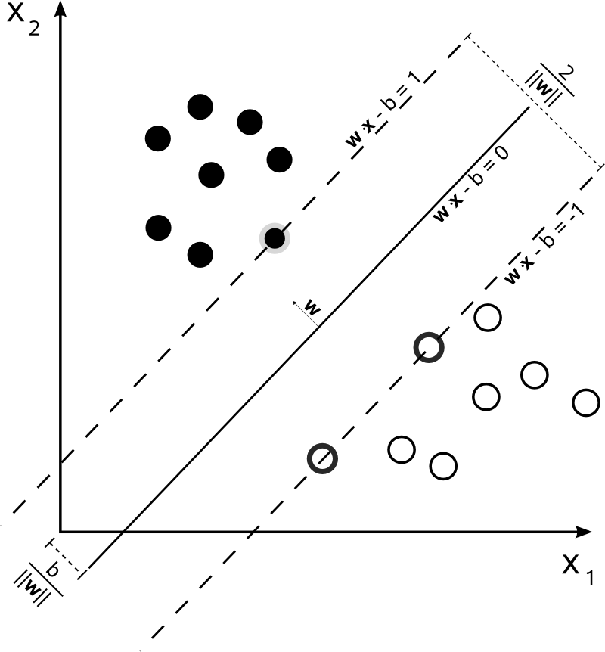
Linear Classifier
This is known to the fastest algorithm especially when the data is sparse.
Reason: Because it updates current weight vector incrementally as new instance become available
An improvement of generalization is Support Vector Machine (SVM)
Main idea of SVM: Find a clean gap that as wide as possible

Slide 22
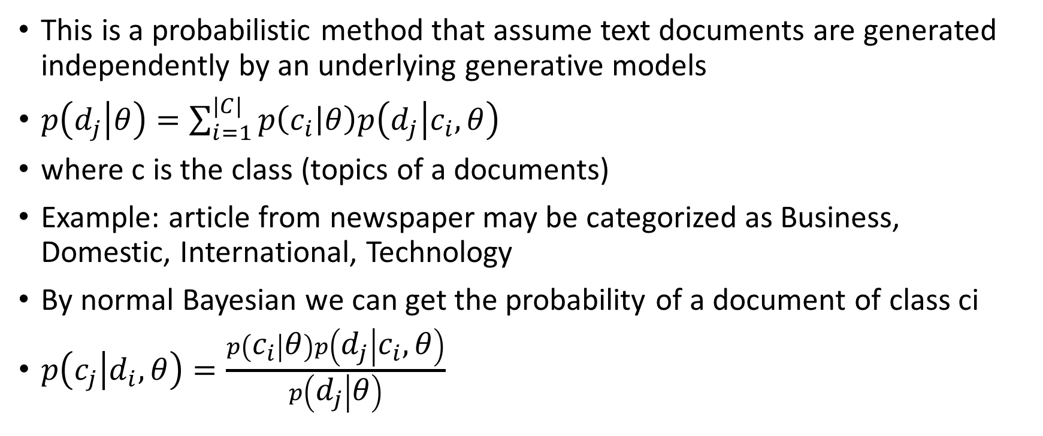
Naïve Bayesian Classifier
This is a probabilistic method that assume text documents are generated independently by an underlying generative models
$p\left(d_{j} | θ\right)=\sum_{i=1}^{|C|}{p\left(c_{i} | θ\right)p\left(d_{j} | c_{i},θ\right)}$
where c is the class (topics of a documents)
Example: article from newspaper may be categorized as Business, Domestic, International, Technology
By normal Bayesian we can get the probability of a document of class ci
$p\left(c_{j} | d_{i},θ\right)=\frac{p\left(c_{i} | θ\right)p\left(d_{j} | c_{i},θ\right)}{p\left(d_{j} | θ\right)}$

Slide 23
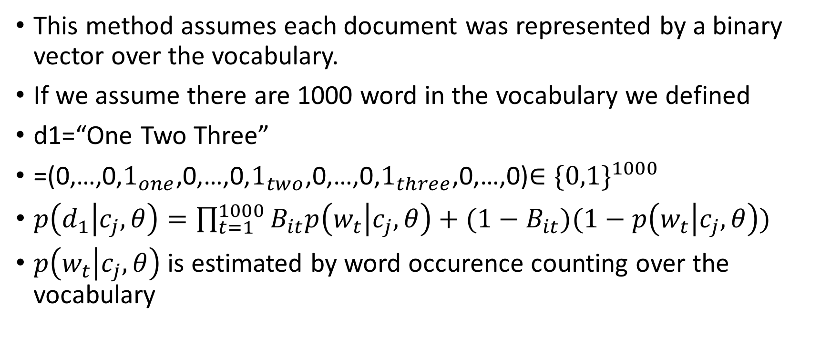
Multivariate Bernouli
This method assumes each document was represented by a binary vector over the vocabulary.
If we assume there are 1000 word in the vocabulary we defined
d1=“One Two Three”
=(0,…,0,$1_{one}$,0,…,0,$1_{two}$,0,…,0,$1_{three}$,0,…,0)$∈{\{0,1\}}^{1000}$
$p\left(d_{1} | c_{j},θ\right)=\prod_{t=1}^{1000}{B_{it}p\left(w_{t} | c_{j},θ\right)+(1−B_{it})(1−p\left(w_{t} | c_{j},θ\right))}$
$p\left(w_{t} | c_{j},θ\right)$ is estimated by word occurence counting over the vocabulary

Slide 24

Multinomial formulation
This method assumes each document are generated by a sequence of independent trials drawn from a multinomial probability distribution
d1=“One One Two Two Three”
$p\left(d_{1} | c_{j},θ\right)=p(5)\prod_{t=1}^{5}{{p(w_t|c_{j},θ)}^{N_{it}}}$

Slide 25
Limitation
We have to accept the content-based recommendation does not apply well when information are not enough to distinguish item user likes from item user dislikes
In this case, we need collaborative recommendations

